Slide 1

Bitcoin Market Trends & Sentiment Analysis
DS 598 Engineering Big Data
Submitted By:
Aashrey Jain, Matthew Maslow, Ishanay Sharma

Slide 2
INTRODUCTION
The Challenge: The cryptocurrency market is highly volatile and influenced by investor sentiment, financial news, and macroeconomic factors—making it difficult for traders to react quickly to rapid price swings.
Traditional Approaches: Focus on historical trends and technical indicators, often missing short-term sentiment signals that can drive price movements before charts respond.
Research Gap: - Real-time sentiment from platforms like Twitter and news outlets offers predictive insights. - Current tools fail to integrate sentiment and market data in a unified, real-time system.
Project Objective: - Build a real-time analytics pipeline using Azure services to combine: (a) Social Sentiment: Twitter and financial news (b) Market Data: Live crypto prices and volume - Provide traders with an early warning system for price volatility driven by sentiment shifts.

Slide 3
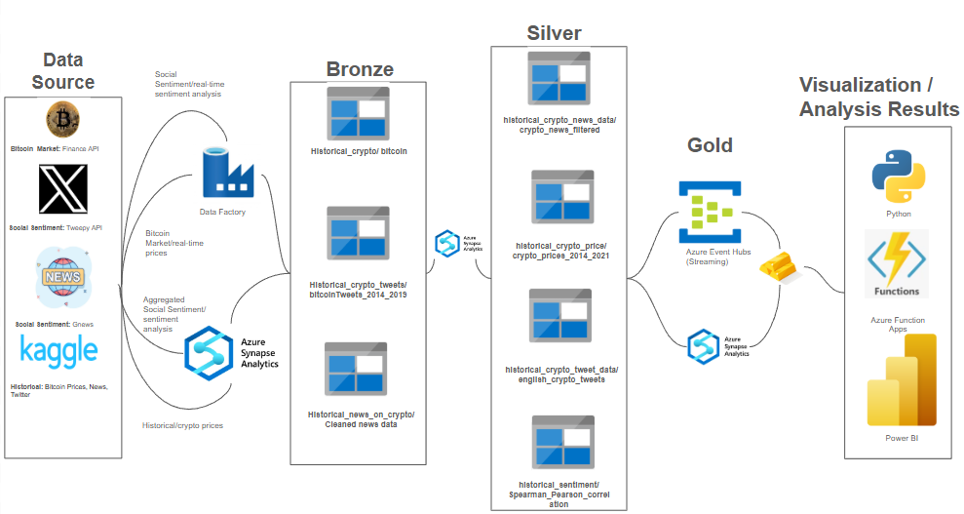
SYSTEM ARCHITECTURE

Slide 4
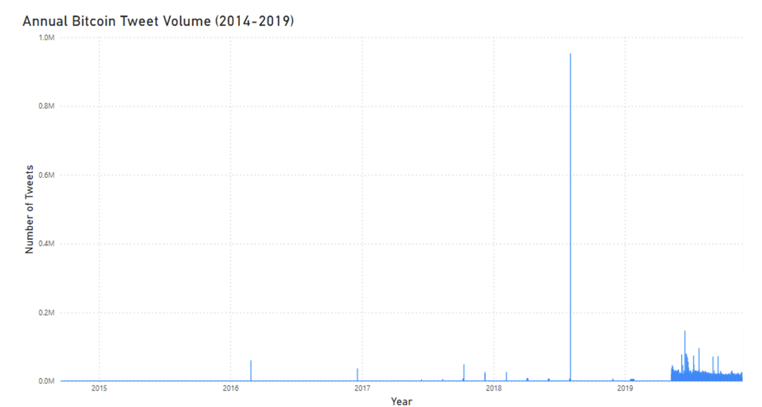
EXPLORATORY DATA ANALYSIS (EDA)

Slide 5
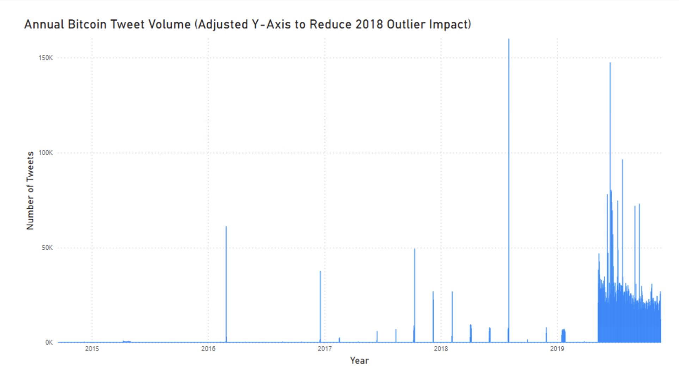
EXPLORATORY DATA ANALYSIS (EDA)

Slide 6
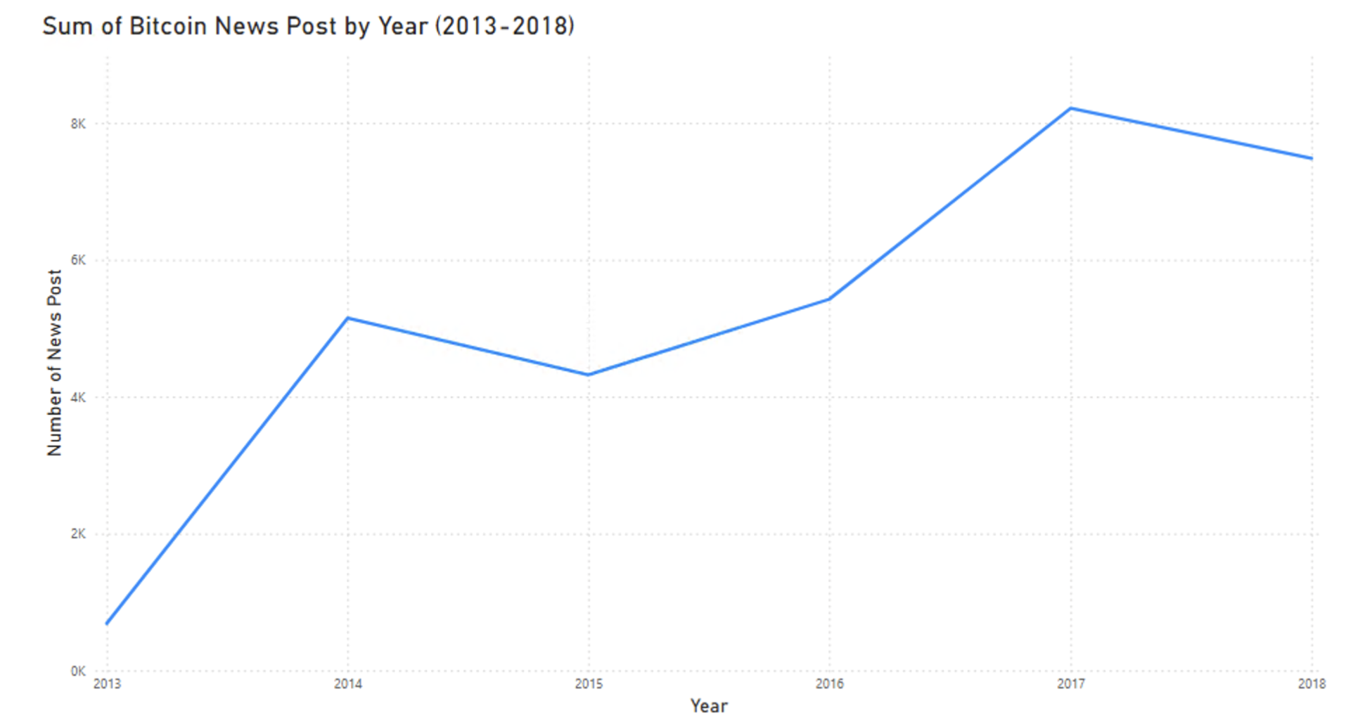
EXPLORATORY DATA ANALYSIS (EDA)

Slide 7
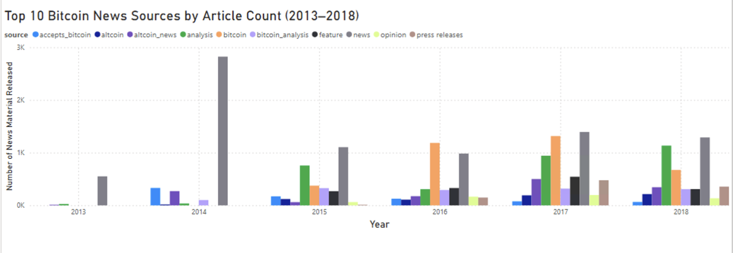
EXPLORATORY DATA ANALYSIS (EDA)

Slide 8
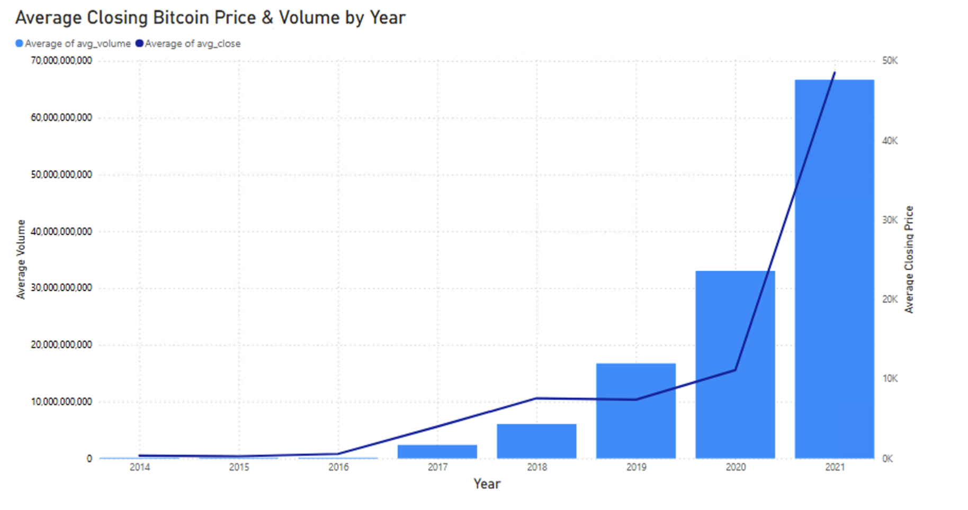
EXPLORATORY DATA ANALYSIS (EDA)

Slide 9
THE SENTIMENTAL MODEL
We selected the Bayesian-tuned HistGradientBoostingRegressor (HGBR) out of a variety of models we tested like Random Forest Classifier,XGBoost Classifier, Logistic Regression,etc. because it offered the best trade-off between prediction accuracy, interpretability, and robustness to missing and imbalanced data.
Among all models tested, it achieved the lowest test RMSE (0.0336), significantly outperforming baseline classifiers and regressors.
We use Bayesian Optimization to fine-tune key hyperparameters such as: learning_rate, max_depth, min_samples_leaf, l2_regularization, and n_estimators

Slide 10
THE SENTIMENTAL MODEL
Input Features were the daily data over the past month including:
Sentiment features: average and rolling sentiment scores from tweets and news
Market features: daily return, volatility, SMA, RSI
Prediction Target: Next-day return of Bitcoin price
Inference Output: A continuous return forecast
Decision Mapping:
Forecast ≥ +0.1% → Buy
Forecast ≤ −0.1% → Sell
Otherwise → Hold

Slide 11
Predictive Data Analytics / Dashboard
https://app.powerbi.com/groups/me/reports/dacf2a61-13b8-4f56-b059-ac9b4055137e/ReportSection3e7beeac784dc7ccd99a?experience=power-bi

Slide 12
KEY FINDINGS
Key Findings:
Short-term sentiment shifts (3–7 day) often align with spikes in volatility, suggesting social media sentiment can act as an early signal for unstable market conditions.
The 14-day RSI showed a consistent relationship with Bitcoin price trends, reinforcing its value as a predictive technical indicator.
Scatterplot clustering by year revealed distinct momentum and pricing behavior, with 2021 standing out due to high price variance and RSI extremes.
Yearly comparisons showed that positive sentiment (especially in 2017 and 2021) often preceded or coincided with price surges, supporting a correlation between public opinion and market optimism.

Slide 13
LIMITATIONS
Limitations:
Data is historical only — the dashboard does not yet incorporate real-time updates, limiting its predictive utility in fast-moving markets.
Sentiment analysis relies on text polarity scores, which may oversimplify or misclassify nuanced language (e.g., sarcasm or context-specific terms).
News and Twitter data may be biased toward highly active periods or topics, potentially skewing averages in favor of high-volume moments.
The analysis assumes equal weight across all sentiment sources and does not account for influence level (e.g., verified accounts vs bots).
No causal claims are made — while correlations are clear, we cannot confirm direct influence of sentiment on price without further modeling.

Slide 14
THANK YOU

